Slide 1
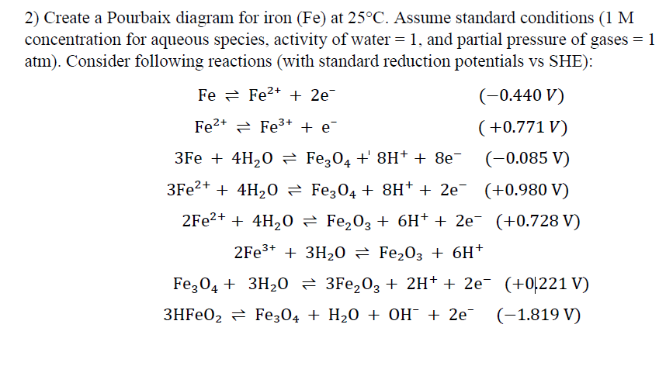

Slide 2
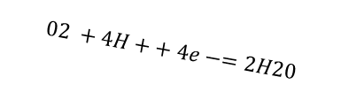
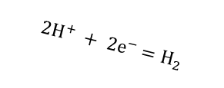
$$02 +4H++ 4e−=2H20$$
Oxygen
Evolutoin
$$2H^{+} + 2e^{−}=H_{2}$$
Hydrogen Evolutoin

Slide 3
Fe³⁺
Fe²⁺
Fe²⁺ ⇌ Fe³⁺ + e⁻
Fe²⁺
Fe
Fe ⇌ Fe²⁺ + 2e⁻

Slide 4
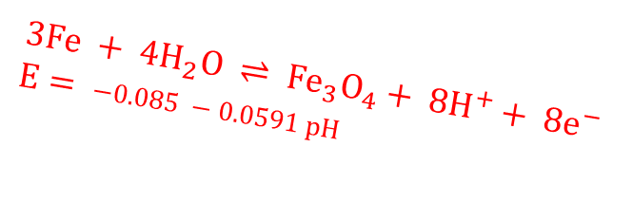


Fe³⁺
Fe²⁺
Fe²⁺
Fe
$${Fe}_{3}O_{4}$$
$$Fe$$
$$3Fe + 4H_{2}O ⇌ {Fe}_{3}O_{4}+ 8H^{+}+ 8e^{−}$$
$$E= −0.085 −0.0591 pH$$

Slide 5
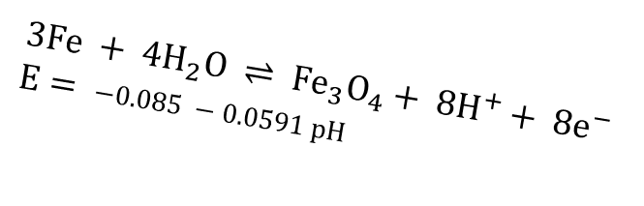
Fe³⁺
Fe²⁺
Fe²⁺
Fe
$${Fe}_{3}O_{4}$$
$$Fe$$
$$3Fe + 4H_{2}O ⇌ {Fe}_{3}O_{4}+ 8H^{+}+ 8e^{−}$$
$$E= −0.085 −0.0591 pH$$

Slide 6
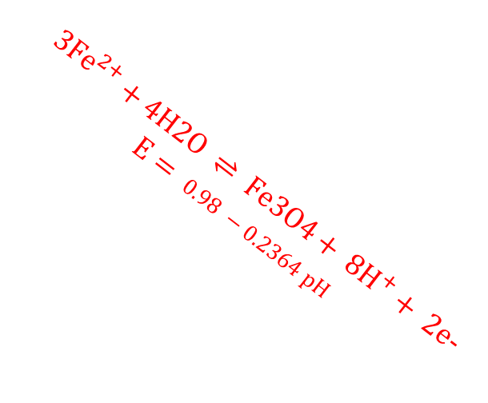
Fe³⁺
Fe²⁺
Fe²⁺
Fe
$${Fe}_{3}O_{4}$$
$$Fe$$
$$3{Fe}^{2+}+4H2O ⇌ Fe3O4+ 8H^{+}+ 2e−$$
$$E= 0.98 −0.2364 pH$$

Slide 7
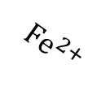
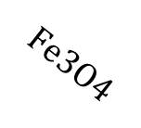
Fe³⁺
Fe²⁺
$$Fe3O4$$
Fe²⁺
Fe
$${Fe}^{2+}$$
$${Fe}_{3}O_{4}$$
$$Fe$$

Slide 8
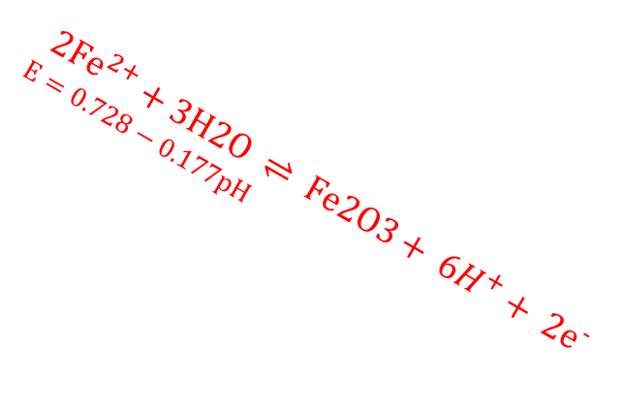

Fe³⁺
Fe²⁺
$$Fe3O4$$
Fe²⁺
Fe
$${Fe}^{2+}$$
$${Fe}_{3}O_{4}$$
$$Fe$$
$$2{Fe}^{2+}+3H2O ⇌ Fe2O3+ 6H^{+}+ 2e^{−}$$
$$E=0.728−0.177pH$$

Slide 9
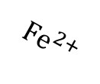
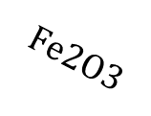
Fe³⁺
Fe²⁺
$$Fe2O3$$
$${Fe}^{2+}$$
$$Fe3O4$$
Fe²⁺
Fe
$${Fe}^{2+}$$
$${Fe}_{3}O_{4}$$
$$Fe$$

Slide 10



$$2Fe³⁺ + 3H₂O ⇌ Fe₂O₃ + 6H^{+}$$
$$pH=−0.242$$
$$Fe³⁺$$
$$Fe₂O₃$$
Fe³⁺
Fe²⁺
$$Fe2O3$$
$${Fe}^{2+}$$
$$Fe3O4$$
Fe²⁺
Fe
$${Fe}^{2+}$$
$${Fe}_{3}O_{4}$$
$$Fe$$

Slide 11
$$Fe³⁺$$
$$Fe₂O₃$$
Fe³⁺
Fe²⁺
$$Fe2O3$$
$${Fe}^{2+}$$
$$Fe3O4$$
Fe²⁺
Fe
$${Fe}^{2+}$$
$${Fe}_{3}O_{4}$$
$$Fe$$

Slide 12
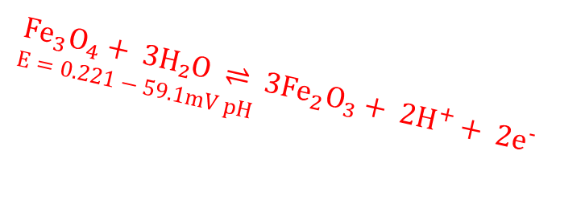
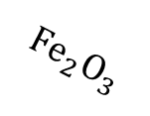

$$Fe³⁺$$
$$Fe₂O₃$$
Fe³⁺
Fe²⁺
$${Fe}_{2}O_{3}$$
$${Fe}^{2+}$$
$$Fe3O4$$
$${Fe}_{2}O_{3}$$
Fe²⁺
Fe
$${Fe}^{2+}$$
$${Fe}_{3}O_{4}$$
$${Fe}_{3}O_{4}+ 3H₂O ⇌ 3{Fe}_{2}O_{3}+ 2H^{+}+ 2e^{−}$$
$$E=0.221−59.1mV pH$$
$$Fe$$

Slide 13

$$Fe³⁺$$
$$Fe₂O₃$$
Fe³⁺
Fe²⁺
$${Fe}_{2}O_{3}$$
$${Fe}^{2+}$$
$${Fe}_{2}O_{3}$$
Fe²⁺
Fe
$${Fe}^{2+}$$
$${Fe}_{3}O_{4}$$
$$Fe$$

Slide 14
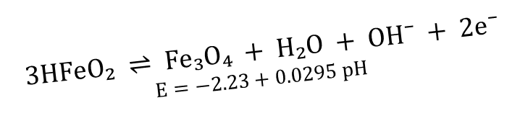
$$Fe³⁺$$
$$Fe₂O₃$$
Fe³⁺
Fe²⁺
$${Fe}_{2}O_{3}$$
$${Fe}^{2+}$$
$${Fe}_{2}O_{3}$$
Fe²⁺
Fe
$${Fe}^{2+}$$
$${Fe}_{3}O_{4}$$
$$Fe$$
$$3HFeO₂ ⇌ Fe₃O₄ + H₂O + OH⁻ + 2e⁻$$
$$E=−2.23+0.0295 pH$$

Slide 15
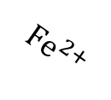
$$Fe³⁺$$
$$Fe₂O₃$$
Fe³⁺
Fe²⁺
$${Fe}_{2}O_{3}$$
$${Fe}^{2+}$$
$${Fe}_{2}O_{3}$$
Fe²⁺
Fe
$${Fe}^{2+}$$
$${Fe}_{3}O_{4}$$
$$Fe$$

